Slide 1
Unemployment and poverty in Pakistan
Allahdad

Slide 2

UNEMPLOYMENT
Unemployment refers to a situation in which the workers who are capable of working and willing to work but do not get job.

Slide 3
Current condition in Pakistan
In Pakistan, unemployment ratio is increasing rapidly and it’s now become the biggest issue that every youth is facing.
Many top universities in Pakistan producing a lot of young graduates but they are failing to get a better job. Currently, more than 300,000 people are unemployed in Pakistan and by ratio is 12%.
The Pakistani rate of unemployment increased by 6.5 percent, and we can say that one out of every 10 persons in the country are experiencing unemployment.
The statistics from the urban areas for the unemployment rate were taken and it increased by 2 percent to 10.1 percent and in rural areas it increased from 4.3 percent to 5 percent.

Slide 4
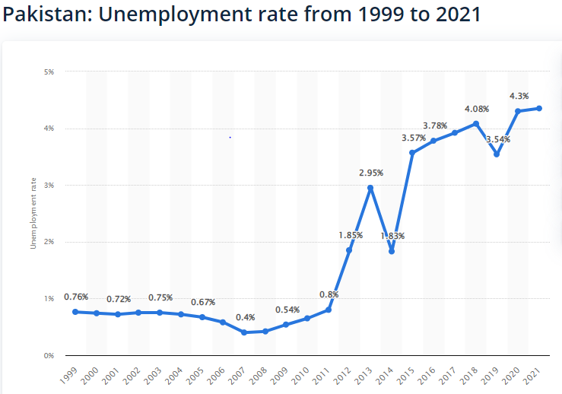

Slide 5
Major causes of unemployment
There are three major causes of unemployment:
Economic causes
Social causes
Financial causes

Slide 6

Economic causes
Pakistan’s economic decline is no longer a mystery in these modern times.
The prices of everyday things have skyrocketed to absurd levels.
As a result, there is a shortage of demand.
Many businesses are suffering from a severe downturn, with an average 5 hundred thousand workers losing their employment in the last ten months.
As a result, the majority of Pakistanis are afraid to start a new business, and as a result, there are no new employment.

Slide 7

Social causes
High population rate
Wide spread illiteracy

Slide 8
High population rate
Country’s Population is growing at an alarmingly rapid rate at the moment. According to official statistics, the population of Pakistan is growing at a pace of 2.2 percent per year.
An increase in population will inevitably result in an increase in the number of ignorant people entering the labor force.
The government or any other organization will be unable to create jobs or work locations for the large number of illiterate persons in the population

Slide 9
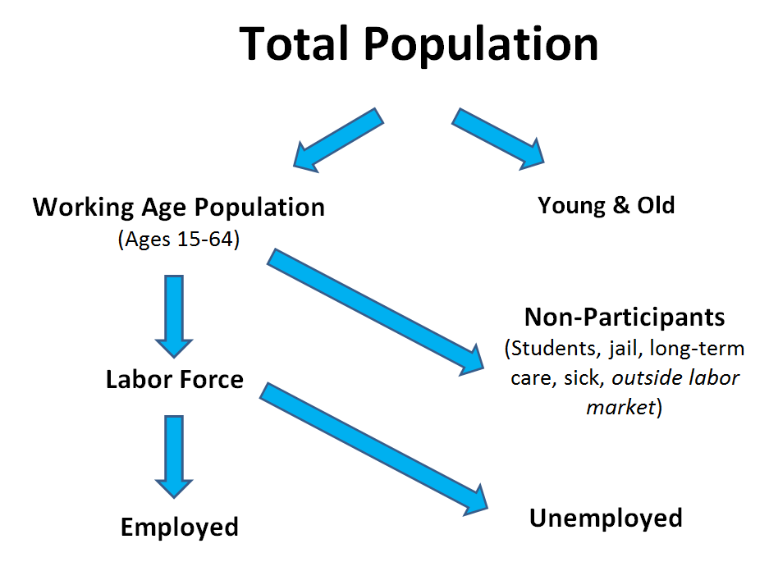

Slide 10
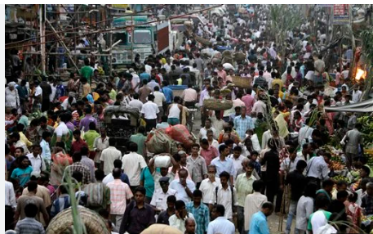

Slide 11
Wide spread of illiteracy
Illiteracy affects an individual in all areas of their life. An illiterate individual cannot read and write
Poverty is the major issue behind the high illiteracy rate in Pakistan
Lack of quality education is one of the major causes of low literacy rate in Pakistan. Pakistani educational system lacks new and innovative methods of teaching

Slide 12
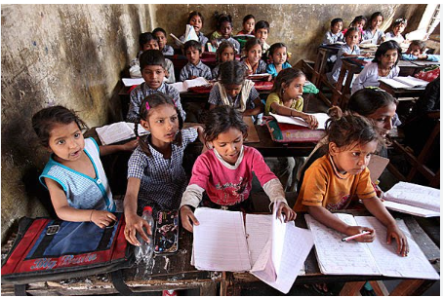

Slide 13

Financial causes
Lack of credit facilities:
It is so difficult to manage personal business and self employment due to absence of easy credit facility.
Accordingly, shortage of credit facility is also a main cause of unemployment.
Deficiency of capital:
There is shortage of capital that leads to low level of savings and investment in Pakistan.
It result in low rate of capital formation and caused in unemployment.

Slide 14

Impact of unemployment
Suicide cases by unemployment
Over the same period , 1,160 cases of attempted suicides were reported. According to the report:
469 people committed suicide for domestic reasons
136 because they were unemployed
193 over disputes within families
74 over the rejection of marriage proposals
85 after fights with parents97 because of poverty
159 for other reasons.

Slide 15
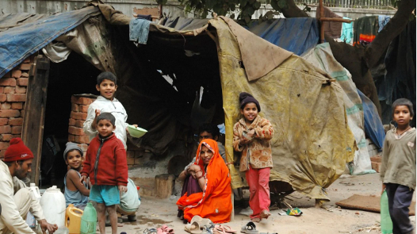
Poverty
Unemployment is one of the key factors that causes people to fall into poverty
The current youth unemployment rate increases the likelihood of future impoverishment, the burden of work falls on the shoulders of future generations. Individuals remain trapped in a poverty cycle in the face of severe unemployment shocks.

Slide 16
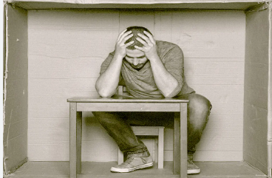
Effects of unemployment for individual include:
Reduce in income
Health problems
Negative familial effects

Slide 17
What can be the solution ?
Given Pakistan’s large population, it will be difficult for the government to resolve one of the country’s most pressing problems, unemployment.
The first step towards reducing unemployment in Pakistan is for the government of Pakistan to develop a comprehensive plan.
It is necessary to build well-recognized training and technical institutes where skills programs can be delivered.
Peace should prevail throughout the country so that foreign investors would not be hesitant to make investments in Pakistan.
Centers for family planning should be established in order to stem the tide of overpopulation.

